Slide 1
Sets
CSE 2213 – Discrete Mathematics

Slide 2


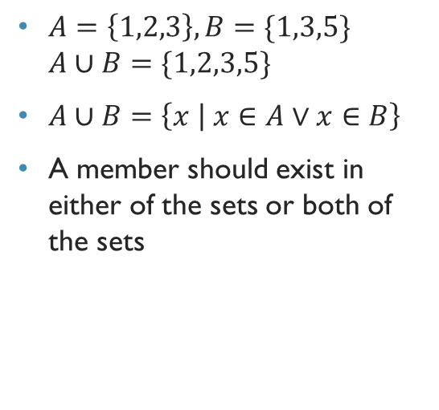









Set operations: Union
$A=\left\{1,2,3\right\}, B=\{1,3,5\}$ $A∪B=\{1,2,3,5\}$
$A∪B=\left\{x | x∈A∨x∈B\right\}$
A member should exist in either of the sets or both of the sets
A $∪$B
U
A
B
Notes:
Brief Intro to Venn Diagrams here

Slide 3



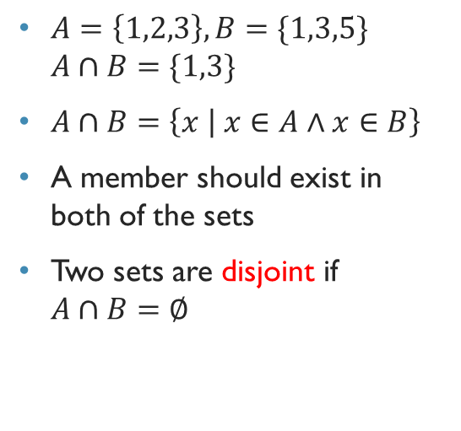



Set operations: Intersection
$A=\left\{1,2,3\right\}, B=\{1,3,5\}$ $A∩B=\{1,3\}$
$A∩B=\left\{x | x∈A∧x∈B\right\}$
A member should exist in both of the sets
Two sets are disjoint if $A∩B=∅$
A$∩$B
U
A
B

Slide 4

Cardinality of union set
$\left|A∪B\right|=\left|A\right|+\left|B\right|−\left|A∩B\right|$
Principle of inclusion and exclusion

Slide 5
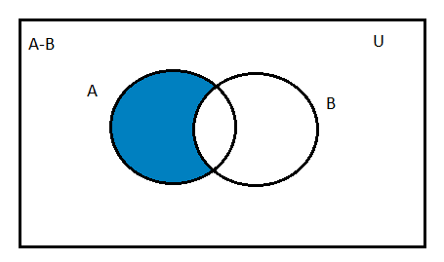
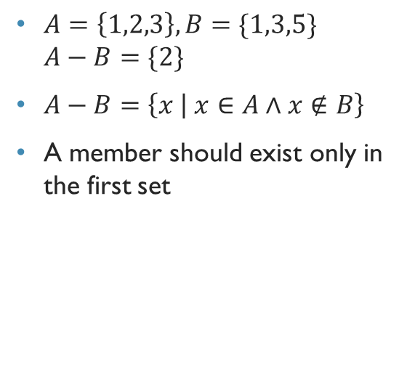
Set operations: difference
$A=\left\{1,2,3\right\}, B=\{1,3,5\}$ $A−B=\{2\}$
$A−B=\left\{x | x∈A∧x∉B\right\}$
A member should exist only in the first set

Slide 6

ComPlement
Let U be the universal set. The complement of the set A , denoted by $\overline{A}$ ,
In other words, the complement of the set A is U - A
A

Slide 7
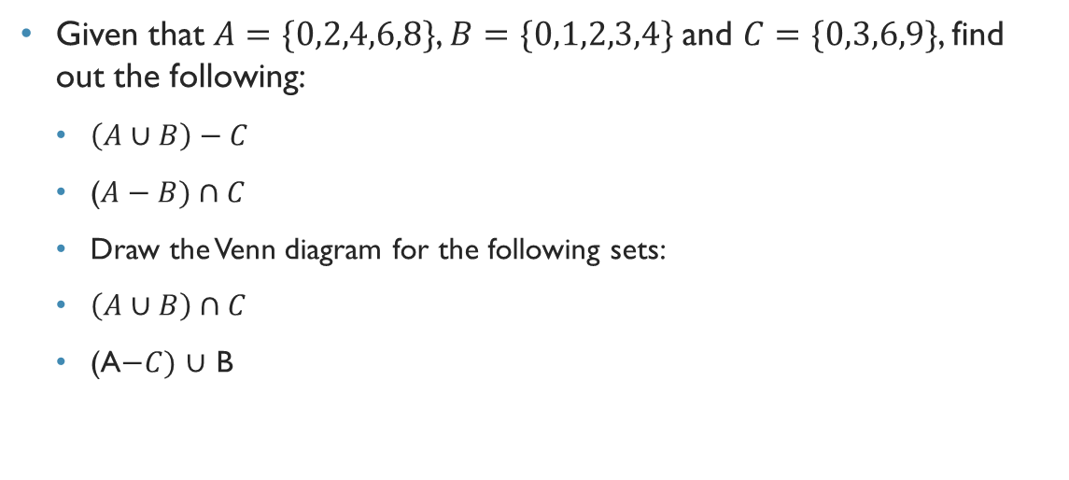
Problem
Given that $A=\{0,2,4,6,8\}$, $B=\{0,1,2,3,4\}$ and $C=\{0,3,6,9\}$, find out the following:
$\left(A∪B\right)−C$
($A−B)∩C$
Draw the Venn diagram for the following sets:
$\left(A∪B\right)∩C$
(A$−C)$ $∪$ B

Slide 8
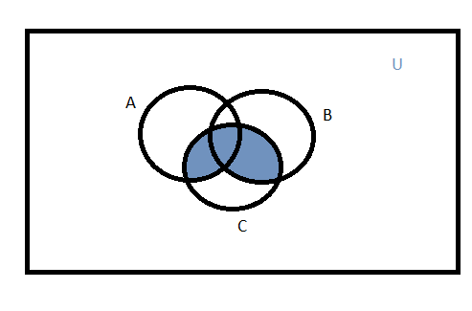
Venn Diagram

Slide 9
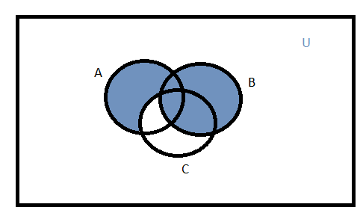
Venn Diagram

